Slide 1
Differentiated Instruction and Inclusion
Vicki LaRiccia
Special Education Teacher, Brookline/ Faculty and Consultant, Berklee
January 13, 2018

Slide 2
Essential Question: What are some differentiation strategies I can use to allow for inclusion in my classroom?
What is differentiation and why is it critical?
Substantially separate environment vs. inclusion

Slide 3
IEP Adaptations & DCAP
UDL
All Students
Differentiation

Slide 4
What is differentiation?
Recognizes that students vary in
background knowledge,
readiness,
language,
preferences,
interactions, and
responses to instruction
(Hall, 2002)

Slide 5
What is differentiation?
Teacher uses a variety of:
ways to explore the curriculum content
sense making activities through which students can construct knowledge
options for students to demonstrate what they’ve learned
(Tomilson, 1995)

Slide 6
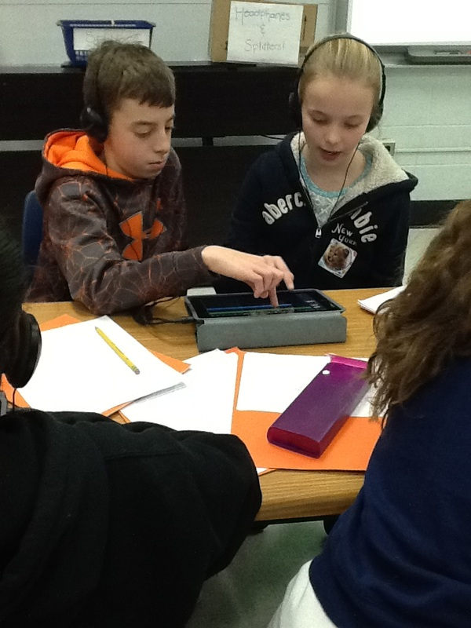
Tomilson’s 4 characteristics of Differentiated Classrooms
Instruction:
focused on concepts, goal is not to “cover” material, but to make sure students have opportunities to explore and apply the key concepts

Slide 7
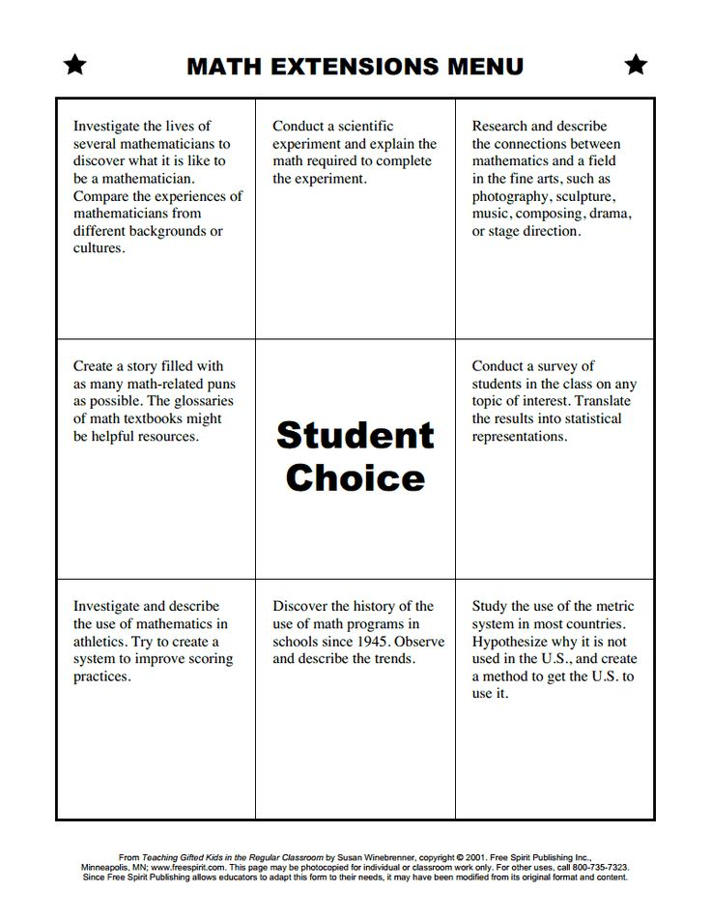
Tomilson’s 4 characteristics of Differentiated Classrooms
2. Assessment:
built into the curriculum, constant, teacher provides support when needed vs. extending exploration when students are ready to move ahead

Slide 8
Tomilson’s 4 characteristics of Differentiated Classrooms
3. Students work in a variety of patterns:
independently, pairs, or groups

Slide 9
Tomilson’s 4 characteristics of Differentiated Classrooms
4. Students actively explore content while teacher GUIDES exploration.
Teacher is facilitator of varied activities that occur at the same time
Student-centeredness increases ownership of learning and supports independence

Slide 10
Differentiated Instruction in the Modern Music Classroom
(Take notes.)
What DI strategies does the teacher mention? What strategies did she NOT mention?

Slide 11
Extension Menu Activity
(if time)
Look at examples of student menus (next slides)
Get into groups of 4
Design a possible extension menu for students who accelerate in your class. Look online for examples. Music menus do not exist!! We are going to create them :)
Tip: Gifted and high-achieving students don’t need more work, they need deeper work.

Slide 12
Extension Menu Activity
(if time)
Middle School Band/Orchestra Menu for working out of a method book
Play with alternate fingerings (stickings/strings) | Create a harmony line or accompaniment for song | Add lyrics to instrumental notation
Re-write song and then play in a new Time-Signature (Half-Time. Double-Time) | STUDENT CHOICE | Re-write song and play in a new clef.
Transpose song into a new key. (Start on a different pitch) | Look up history and context of the music | Arrange as a duet or trio

Slide 13
Extension Menu Activity
(if time)
Guitar Class Extension Menu
Learn to play the notes that you already know in a new position (or chords)! | Try a new song or style of music INSTEAD of the basic introductory pieces we are working on | Compose a chord progression or solo of your own!
Transcribe a song of choice! | STUDENT CHOICE | Teach a friend your favorite song!
Find a guitarist for us to watch in class and be ready to tell us about them! | Try creating a new version of a song you already know! | Cover a song assigned by ME in your own way!

Slide 14
Tomilson’s 3 Elements
that can be differentiated
Content - teachers focus on concepts, principles, and skills
Process - flexible groupings, classroom management, student choice
Product - ongoing assessment, used as a teacher tool, students are active/responsible explorers and feel challenged, balance between teacher-assigned and student-selected tasks

Slide 15
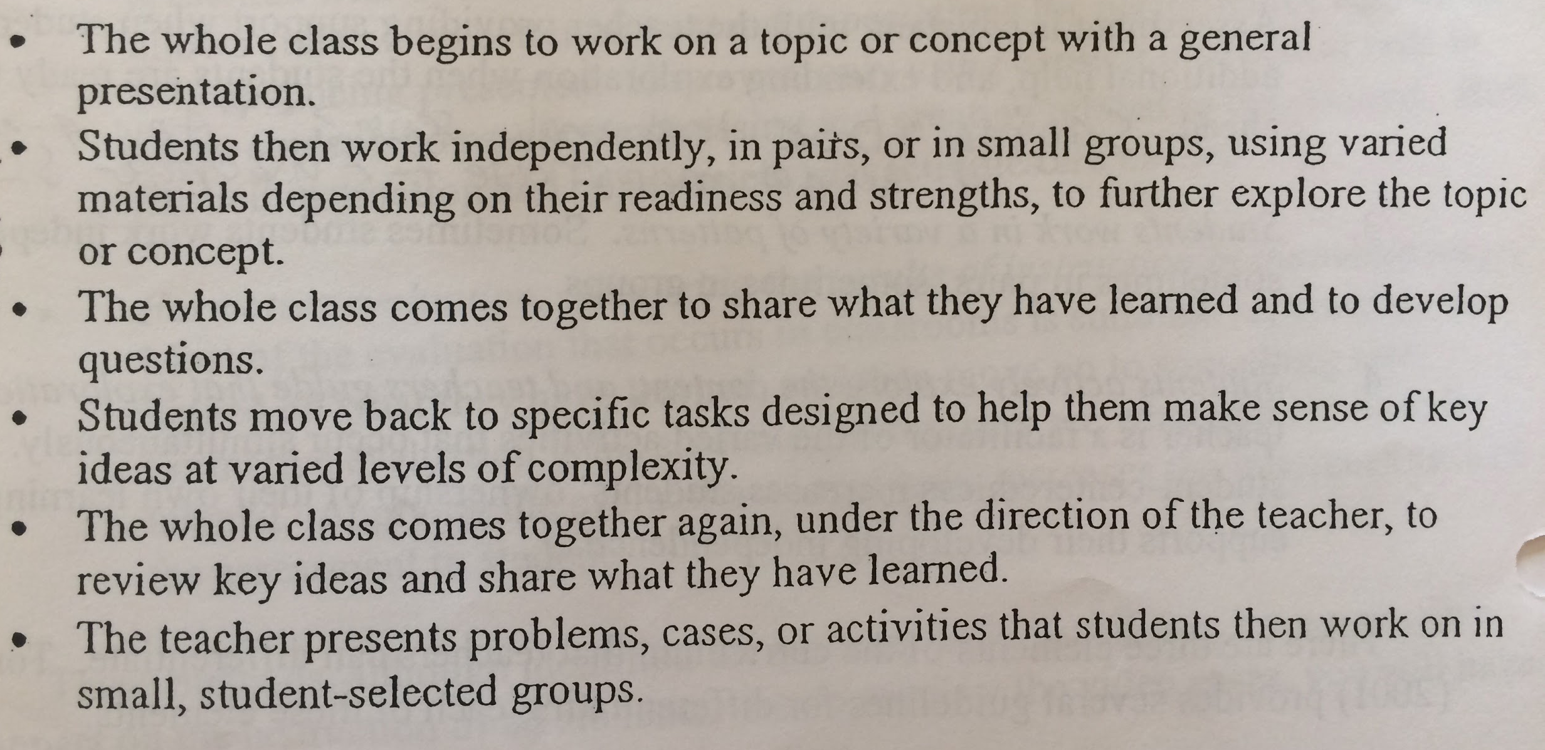
Differentiated Instruction Flow

Slide 16
In summary, DI’s principles include:
The teacher understands, appreciates, and builds upon student differences
Assessment and instruction go hand-in-hand
The teacher adjusts the content, process, and product in response to students’ readiness, interests, and learning profile.
All students participate
Students and teachers collaborate in learning
FLEXIBILITY is the hallmark of a differentiated classroom

Slide 17
Why is DI critical?
What happens if you don’t have a DI classroom?

Slide 18
Inclusion
When you incorporate DI, UDL, and adaptations from IEPs, you create a maximum inclusion environment! Go you! More students will be able to access your curriculum and learn with their peers.
Substantially Separate
If you don’t use DI, UDL, or adaptations from IEPs, students WILL struggle in your class and may be pulled out for another service, when they can’t learn with their peers.

Slide 19
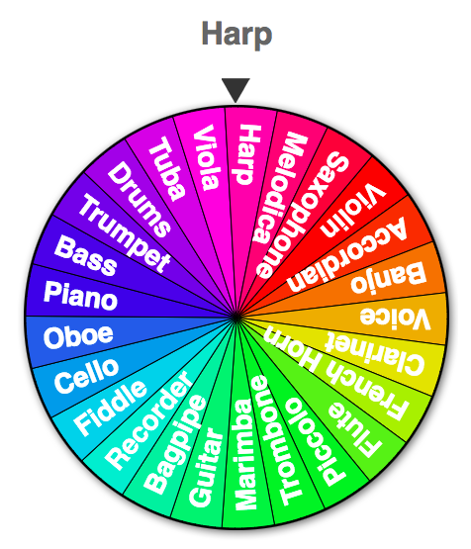
Traditional or Differentiated?
Get into groups of four and pick an instrument
Decide if the strategy is from a traditional classroom or a differentiated classroom
If from a traditional classroom, state how you would differentiate the strategy

Slide 20
KAHOOT!

Slide 21
Thank you!

